Slide 1
Sanskruti Shingala - AU1940124
Mansi Savaj - AU1940158
Krinal Boghani - AU1940195
Udit Kapadia - AU1940214
Machine Learning (CSE523)
Group 8 - Team MUSK

Slide 2
Introduction
Stock market prices are characterized as non-linear, dynamic and irregular in nature.
To maximize the profit and minimize the loss, stock market prediction examines previous data and estimates future data.
Machine learning has been widely used to provide a new mechanism that can help investors to make better investments.
Machine learning does not provide an exact result, it can anticipate the value.

Slide 3
Problem Statement
Stock Price Predictor
Develop a Predictor that best fits a model which can predict:
1) Upcoming Trends of the Stock
2) Closing Prices for Particular stock

Slide 4
Timeline
Implementation
04
Implemented algorithms of multiple linear regression followed by moving average
Data Selection
03
Selected data of 3 companies of 5 year time period
Data Analysis
02
Analysed the trends of closing prices of various stocks
Research
01
Reviewed Research papers and existing Models/Projects

Slide 5
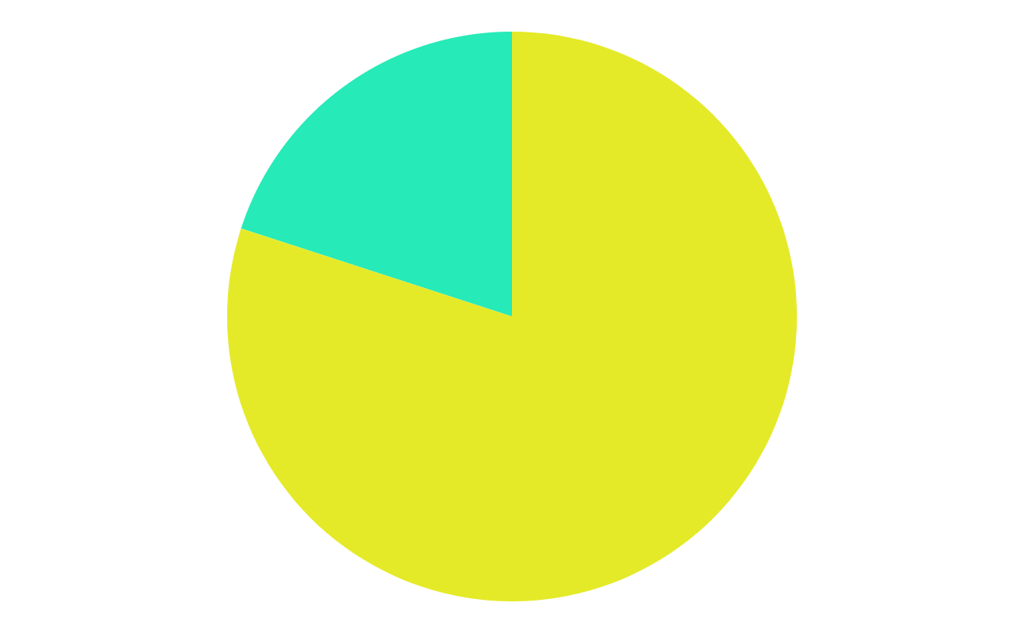
Data Selection
80%
Vodafone: Chosen Randomly
Axis Bank & Asian Paints: They had very fluctuating data since last 7-8 years
Training Dataset
Year: Jan-2015-2019
20%
Test Dataset
Year: Jan-2019-Jan-2020
Time-Period:
Selected data of 5 years
January 2015 - January 2020

Slide 6
Feature Analysis
6 main features: open price, high price, low price, close price, adj close price, volume
Selected feature for analysis: Closing price
Closing price determines the conclusive price for any stock on any particular day due to the effects of various events during the day.
We chose closing price as a dependent variable/feature because it helps in understanding the activity of any stock for any particular day in comparison with the opening price.
Aggregated effect of daily events can be observed on closing price.
However, opening price just gives idea about the price at which trade has been started.

Slide 7
Data Analysis
Initial (Crude) Data Analysis-
Observed the Trends of closing price various Stocks in the Indian Stock Market.
Impacts of external factors like Company Decisions, Government Announcements (Subsidies or Newer Projects, etc), Budget and Earnings Announcements by the Board of Directors, Changes in Central Management etc.
Other stimuli like International Relations of Nations and States of Conflicts, Seasonal Changes and Changes in Availability of the Resources in the Nation.
On later stages-
We did a technical analysis of several stocks observing the patterns that they have followed since inception (inclusion) of particular stocks.
Observed Chart Patterns in Linear and Candle Graph formats.

Slide 8
Approach
01
02
Multiple Linear Regression
Moving Average

Slide 9
Linear Regression Method
The most basic machine learning algorithm that can be implemented on this data is linear regression.
returns an equation that determines the relationship between the independent variables and the dependent variable.
Equation:
Y= Θ+ Θ1*x1 + Θ2*x2 + Θ3*x3 + …. + Θn*xn
Where, x1, x2, x3,....,xn are dummy variables of days of week

Slide 10

Moving Average Method
Smoothing method
Based on the concept of averaging random fluctuations in the time series to identify the underlying direction in which the time series is changing.
A_{t} is observed value in period t
F_{t} is predicted for period t.

Slide 11
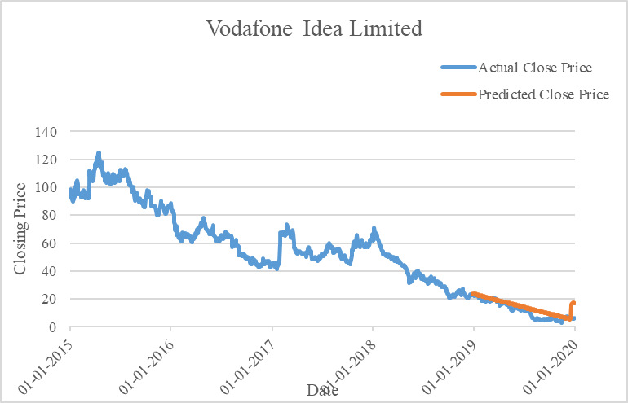
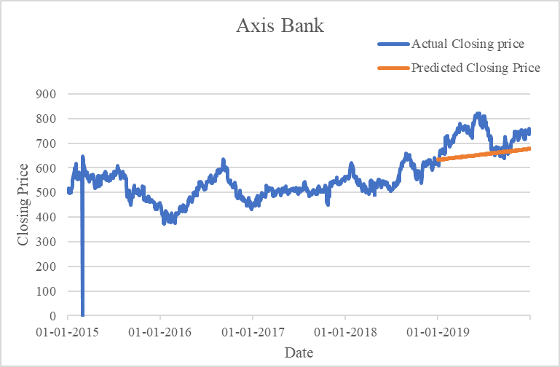
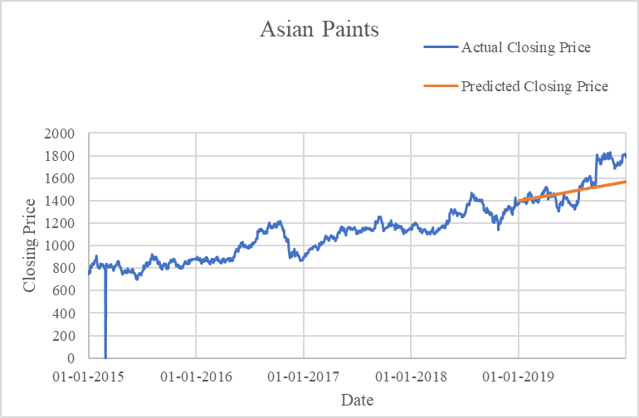
Results with Linear Regression Model
Vodafone-Idea
Axis Bank
Asian Paints
RMSE Value = 3.7707
RMSE Value = 84.5568
RMSE Value = 131.6663

Slide 12
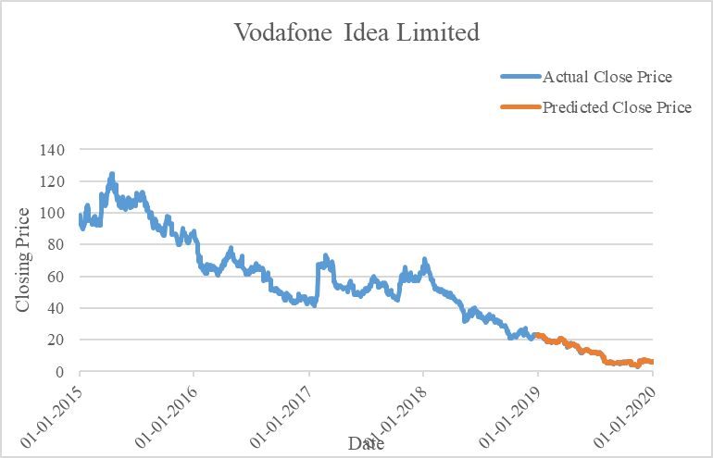
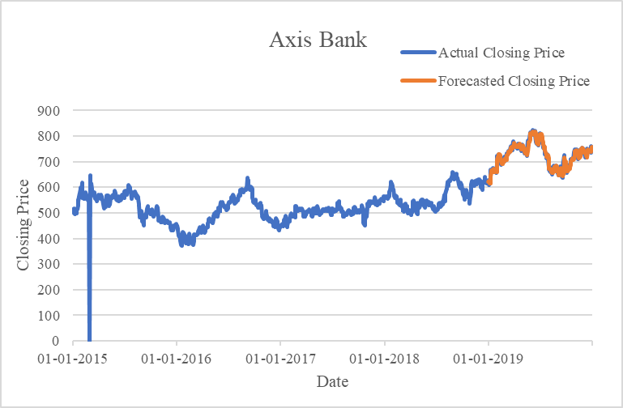
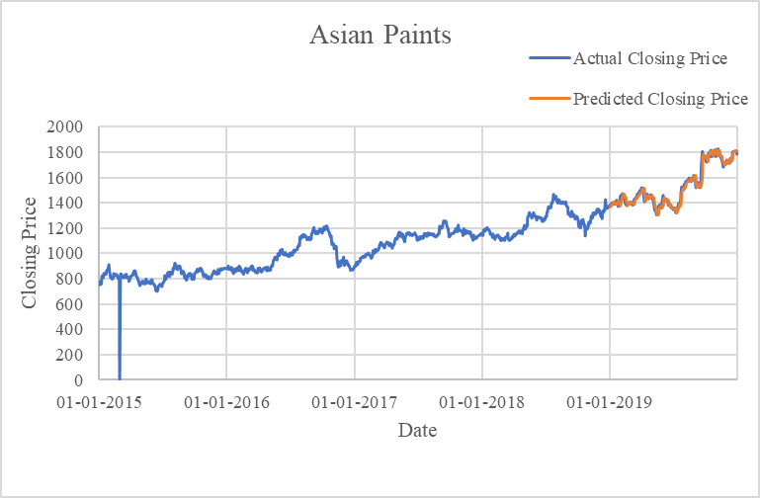
Results with Moving Average of Period 2
Vodafone-Idea
Axis Bank
Asian Paints
RMSE Value = 0.591515
RMSE Value = 13.2567
RMSE Value = 25.3334

Slide 13
Reason for choosing Moving average over Multiple Linear Regression Model
We wanted a model which can predict closing price on the basis of past 3-4 days closing price
We got lower RMSE values for Moving Average Model
Got more accurate values than multiple linear regression model

Slide 14
Reasons for missing Linear Regression
In linear regression, we have used days as variables.
This model overfits the date and month column.
Rather than considering the previous values from the point of prediction, the model considered the value from the same date in the previous month or a year ago.
Hence, the Linear Regression model is not a good model for our data set.
We want more significant independent variables to best fit the model

Slide 15
Conclusion
RMSE values of Linear regression model is quite higher than moving average model (at 2 period moving average)
Linear Regression model performs poorly on required dataset
model overfits the date and month column
Independent variables used are not significant
Moving Average gives better RMSE values with accuracy in predicted closing prices
Moving Average is better model than linear regression Model

Slide 16
Future Work
Better method that can fit the data well shall be used
To work on more ML algorithms that can more accurately forecast the required data

Slide 17
Role of each group member
Sanskruti Shingala (AU1940124)
01
Research, Moving Average Model training and fitting, Data Handling, Presentation Preparation
Mansi Savaj (AU1940158)
02
Research, Linear Regression Model training and fitting, Report Writing, Presentation Preparation
Krinal Boghani (AU1940195)
03
Research, Moving Average Model training and selection, Data Handling, Presentation Preparation
Udit Kapadia (AU1940214)
04
Research, Linear Regression model training, Report Writing

Slide 18
References
[1] Harper, D. R. (2022, February 3). What drives the stock market? Investopedia. Retrieved March 21, 2022, from https://www.investopedia.com/articles/basics/04/100804.asp
[2] Obthong, Tantisantiwong, Jeamwatthanachai, & Wills. (2020, May 6). A survey on machine learning for stock price prediction: Algorithms and techniques. ePrints Soton. Retrieved March 21, 2022, from https://eprints.soton.ac.uk/437785/
[3] Money Control. (n.d.). Historical prices of stocks and indices. English. Retrieved March 21, 2022, from https://www.moneycontrol.com/stocks/histstock.php?ex=b&amp;sc_id=ic8&amp;mycomp=vodafone+idea+limited

Slide 19
Thank You!

